Slide 1



Report on Working of Ward Committees in the City of Mumbai and Civic Problems Registered by Citizens
(January 2012 to December 2014)
Supported by:
FORD FOUNDATION

Slide 2
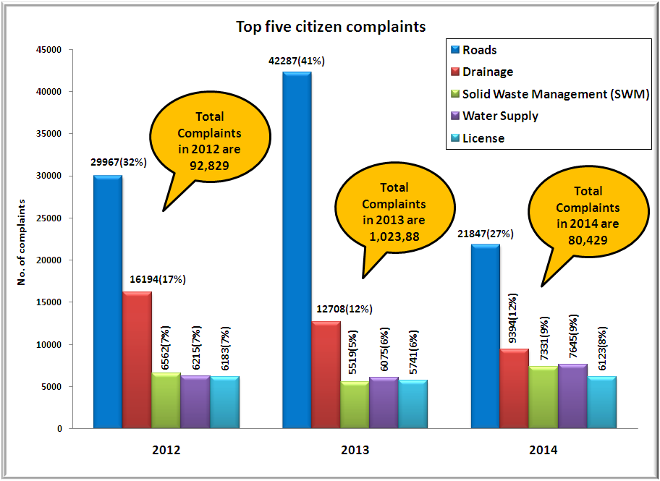
Comparison between top five citizen complaints from 2012 to 2014
In last three years, complaints on ‘Roads’ are highest; complaints on ‘SWM’ and ‘Water Supply’ have increased by 12% & 23% respectively.

Slide 3
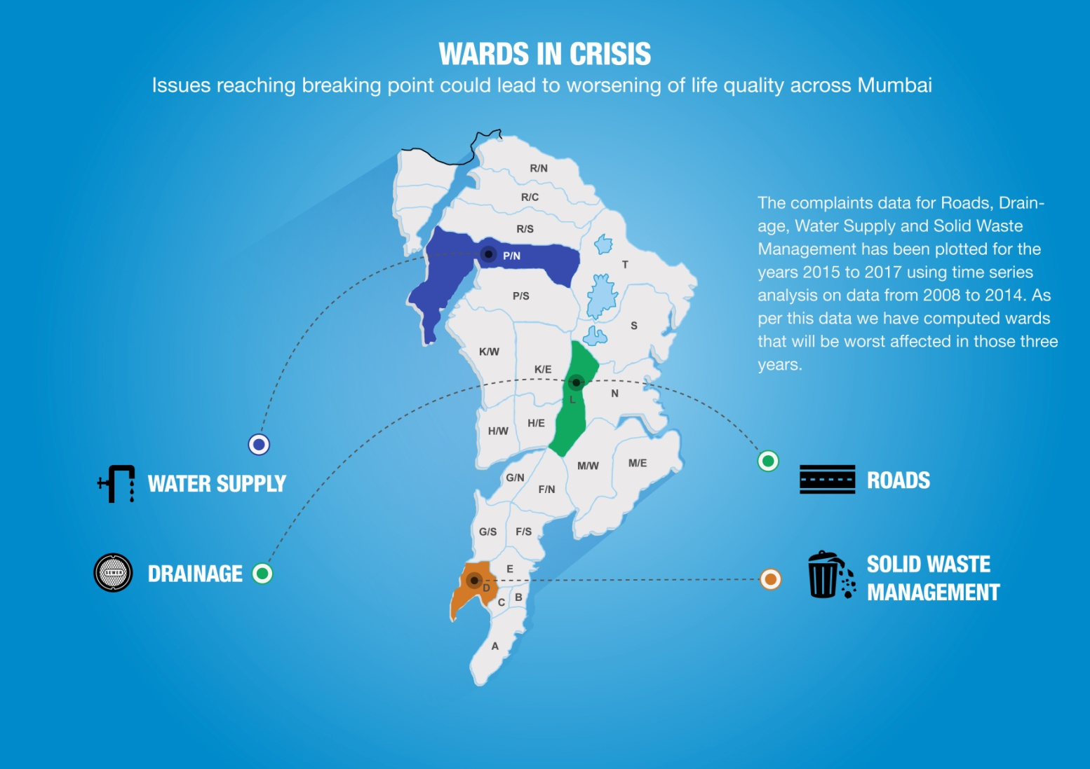

Wards in Crisis

Slide 4
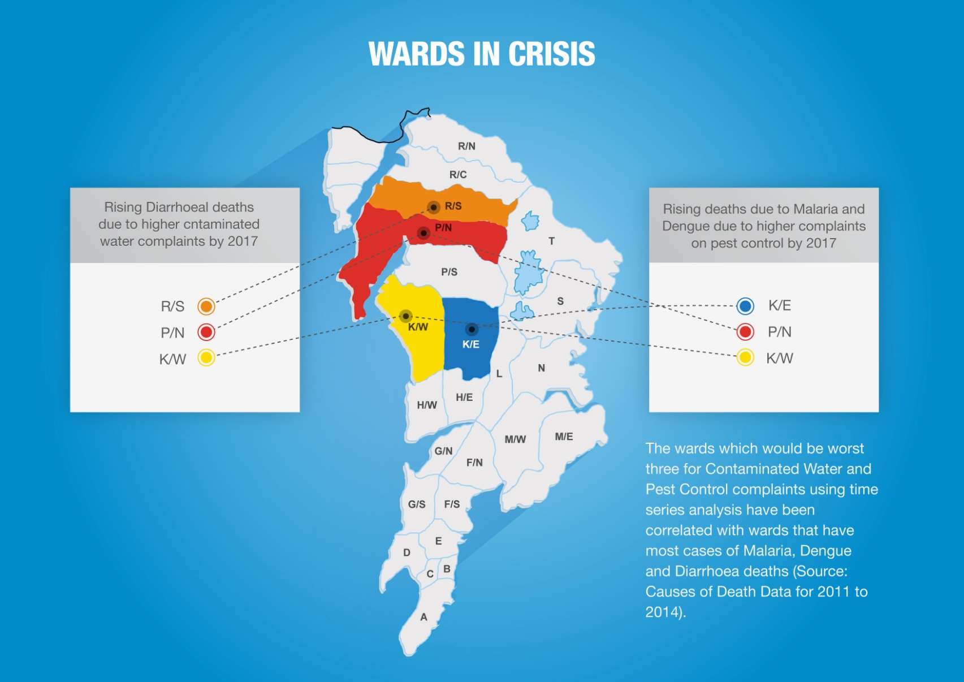
Wards in Crisis

Slide 5
Analysis of complaints attended (closed) in comparison with days mentioned in MCGM’s Citizens’ Charter
Complaint to be attended as per Citizens' Charter | To be resolved as per Citizens' Charter | Actual time taken to resolve in 2013 | Actual time taken to resolve in 2014
Drainage Chokes and Blockages | 1 | 7 | 17
Overflowing drains or manholes | 1 | 14 | 18
Replacement of Missing / Damaged Manhole | 1 | 16 | 21
Repairs to pipe sewers/main sewers | 7 | 17 | 20
Contaminated Water Supply | 1 | 12 | 16
Leaks in Water Lines | 7 | 13 | 17
Shortage of Water Supply | 2 | 12 | 18
Garbage not lifted - Co-authorized Point | 1 | 14 | 16
Providing/removing/replacing dustbins | 8 | 18 | 17
Sweeping of road | 1 | 14 | 18
Other Complaints | 3 | 15 | 16
Average days | 3 | 11 | 17
In 2014, MCGM took 17 days to attend to a complaint, instead of 3 as per Citizens’ Charter.

Slide 6
Wards affected most by poor redressal of civic complaints
87 days taken to resolve ‘Contaminated Water Supply’ complaints in S ward
59 days taken to resolve ‘Repairs to pipe sewers/main sewers’ complaints in H/E ward
71 days taken to resolve ‘Burst Water Main’, 44 days to resolve ‘Shortage of Water Supply’ & 42 days to resolve ‘Leaks in Water Lines’ complaints in K/W ward
50 days taken to resolve ‘Providing/removing/ replacing dustbins’ complaints in D ward
45 days taken to resolve ‘Replacement of Missing/ Damaged Manhole’ complaints in T ward
44 days taken to resolve ‘Shortage of Water Supply’ complaints in T ward

Slide 7
Total number of Meetings, Attendance and Questions from March 2012 to December 2014
Ward Committee
Year | Total Meeting | Attend in (%) | Total Question
Mar’12 to Dec’12 | 209 | 82% | 679
Jan’13 to Dec’13 | 265 | 79% | 989
Jan’14 to Dec’14 | 298 | 71% | 972
In 2014, Attendance down to 71% Only 3 questions were asked per meeting.

Slide 8
Number of questions asked by Councillors from March 2012 to December 2014
Category | No. of Members
 | Mar’12 to Dec’12 | Jan’13 to Dec’13 | Jan’14 to Dec’14
Zero Question | 44 | 19 | 26
1 to 5 Question asked | 149 | 142 | 134
6 to 10 Question asked | 31 | 54 | 47
Above 10 Question asked | 3 | 12 | 20
Total Members | 227 | 227 | 227
27 Councillors have not asked a single question.
There are 3 councillors (Anita Yadav, Jyotsna Parmar & Ujjwala Modak) who have not asked a single question in three years.
Anant Nar has asked most (18) questions.

Slide 9
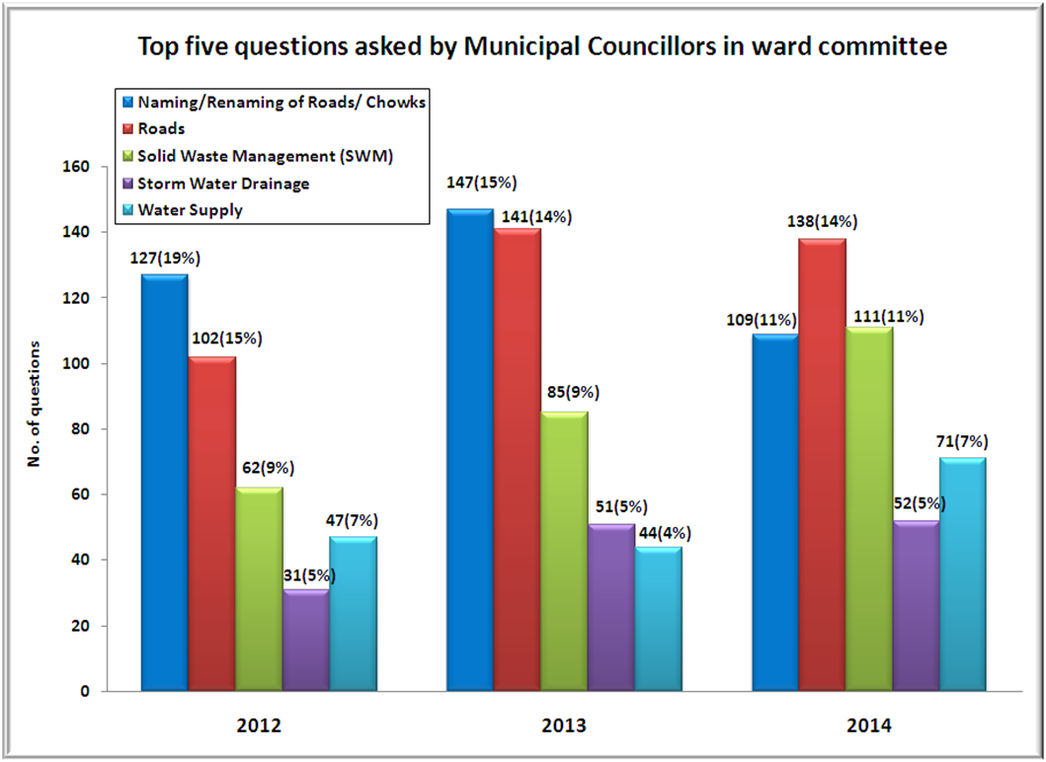
Top five questions asked by Municipal Councillors in ward committee
In 2014, most (138) questions asked were on ‘Roads’ followed by (109) ‘Naming/Renaming of Roads/Chowks.

Slide 10
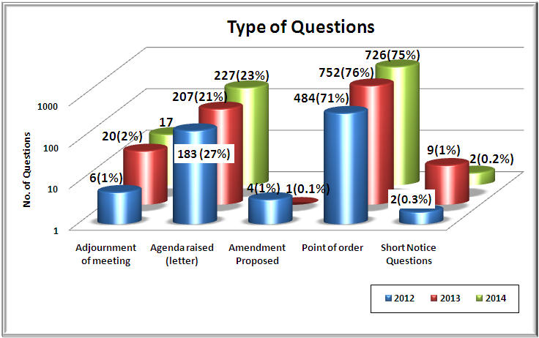
Types of devices used by councillors from 2012 to 2014
In 2014, Out of a total 972 questions, 726(75%) were Point of Order questions. None of the Councillors used Amendment Proposed device. In comparison to 2013, Agenda Raised (Letter) device used by Councillors increased by 2% in 2014.

Slide 11
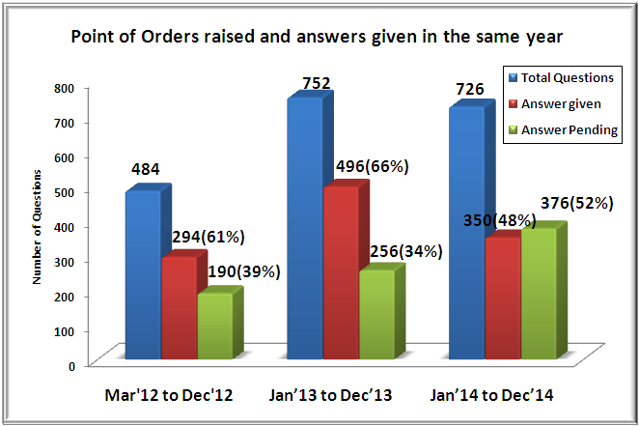
Answers given by Administration to Point of Order questions raised in Ward committee meetings in Year 2014
In 2014, out of 724 point of orders, Administration has given answers to only 350 (48%), and 374 (52%) Point of Orders are pending.

Slide 12
Councillors Holding 2 ‘Offices’
Name of Councillors | MLA/MP | Party
Ameet Satam | MLA | Bharatiya Janata Party
Ashok Patil | MLA | Shiv Sena
Manisha Chaudhary | MLA | Bharatiya Janata Party
Selvan R Tamil | MLA | Bharatiya Janata Party
Sunil Prabhu | MLA | Shiv Sena
Rahul Shewale | MP | Shiv Sena
When an MLA becomes MP they have to leave one of the elected ‘office’; similarly, in states like Delhi, Municipal Councillors (MC) also have to leave their ‘office’ if they get elected as MLA or MP.
The Mumbai Municipal Corporation Act, 1888 needs to be modified so that a person can hold only one elected office (MC, MLA or MP).

Slide 13
What Municipal Councillors need to do
Functioning of Ward Committees needs to be strengthened. This can happen only through effective deliberation by councillors, on constituency-wise civic issues, using appropriate devices in Meetings.
Councillors need to study civic issues pertaining to their constituency, prepare their agendas and push these in the Committee meetings in a planned way.
Councillors need to follow up with the Administration regularly and demand answers.
Councillors need to demand from Administration monthly report of Citizens’ Complaints in the Ward Committee meetings.

Slide 14
How to strengthen MCGM’s Complaint Redressal Mechanism
Emphasis on the need for a technologically advanced, centralised, user-friendly and effective complaints redressal mechanism.
Integration of all complaint portals with Central Complaint Registration System (CCRS).
Officers need to include an ACTION TAKEN REPORT (ATR) on the complaints, which should include the councillor code number to track down the officer who has/should have resolved the complaint. ATR should be shared with the complainant.
Complaint should be closed only after satisfaction of the complainant.
A periodic complaint audit should be done and corrective actions should be taken including linking it to performance appraisals of concerned officers.
A robust Standard Operating Procedure (SOP) needs to be adopted and strictly followed by the administration for redressing complaints.
Citizens need to participate more actively by using grievance systems and pressurise the Municipal Corporation to provide better civic services.

